Slide 1

DEFENCE SERVICES TECHNOLOGICAL ACADEMY
DEPARTMENT OF ELECTRONICS ENGINEERING
M.E
1st SEMINAR
DESIGN AND IMPLEMENTATION OF ADAPTIVE TRAFFIC
SIGNAL CONTROL SYSTEM
Supervised by
Lt.Col: Zaw Zaw
Presented by
Captain. Aung Min Khant
26th .February. 2020

Slide 2
Outlines of Presentation
Abstract
Aims and Objectives
Introduction
System Overviews of Adaptive Traffic Signal Control System
Main Control Unit
Main Control Unit Flow Chart
Functions of Main Control Unit
Object Detection and Classification
Webster’s Method
User Datagram
Traffic Control Unit
Flow Chart
Functions of Upper Controls Units
Conclusions
Future works
2

Slide 3
Abstract
Traffic Congestion is the major problem which every country faces .
The simplest way for controlling a traffic light is using timer for each phase.
Another way is to use electronic sensors in order to detect vehicles, and produce signal that cycles.
This system control the time interval of the traffic light based on traffic density for controlling the traffic light by image processing.
Camera will be installed alongside the traffic light.
Capture image sequences and then analyze using digital image processing for vehicle detection, and according to traffic conditions on the road, that control traffic signal timing.
3

Slide 4
Aims and Objectives
To develop adaptive traffic signal control system which system will reduce traffic congestion issue.
To study Webster’s Methods.
To study image processing with python.
To study OpenCV framework and image processing techniques.
To study object detection and classification with deep neural network.
To study User Datagram Protocol in Ethernet communication.
To reduce traffic congestion, time, cost and energy.
4

Slide 5
Introduction
The timing of a traffic signal is continuously adjusted based on the changing arrival patterns of vehicles at an intersection.
Collect data using Camera.
Evaluated and signal timing improvements are developed.
Finally, implement signal timing updates.
Adaptive signal control typically improves travel time and delay by 10 percent and as much as 50 percent at locations with outdated signal timing plans.
The process is continuously repeated internally by the system hardware or software.
5

Slide 6
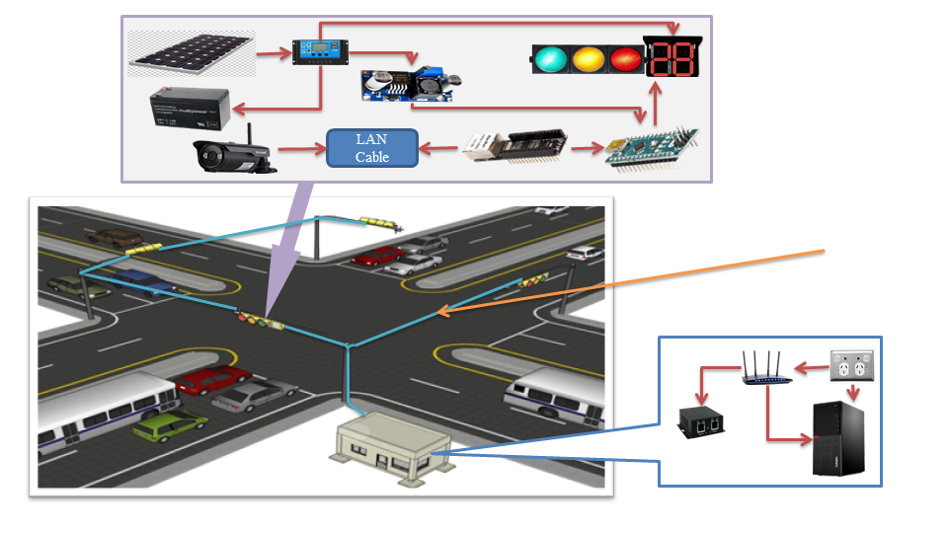
System Overview of Adaptive Traffic Signal Control System
Traffic Control Unit
LAN cable
Main Control Unit
6
Figure(1). System Overview of Adaptive Traffic Signal Control System

Slide 7
Figure(2). Block Diagram of Adaptive Traffic Signal Control System
Continued;
Solar Panel
DC Power Supply
IP Camera
Router
Ethernet Shield
Arduino Nano
Micro Controller
LEDs
Main Controller
74HC595
Shift Register
AC Power Supply
Seven Segments LED
Main Control Unit
Traffic Control Unit
7

Slide 8
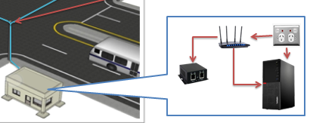
Main Control Unit
Computer
Router
LAN Repeater
AC power source
Figure(3). Main Control Unit
8

Slide 9
Functions of Main Control Unit
Collect Traffic Data from each Camera.
Objects Detection, Classification and Counting.
Server for each traffic control unit.
Calculate traffic timing signal for each phase.
Send update timing cycle to traffic control units.
Receive confirmation at the end of each cycle.
Store Traffic Data into MySQL Database.
9

Slide 10
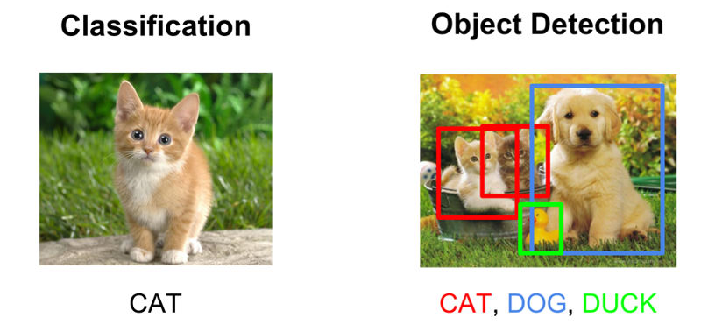
Object Detection and Classification
The process of finding out the particular objects in the images.
The process of classifying images on the basis of recognized features or characteristics is known as classification.
Figure (4). Different between Object Detection and Classification
10

Slide 11
Background Subtraction Techniques
The moving parts of a scene by segmenting it into background and foreground.
Detecting the moving objects from the difference between the current frame and a reference frame.
Video File
Frame Extraction
RGB to Gray Scale Conversion
Background Subtraction in Gray Scale
Vehicle Counting
Gray Scale to Binary Conversion and Morphology Operation
Figure (5). System Design for Vehicle Counting
11

Slide 12
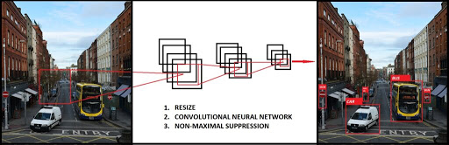
YOLOv3 Framework
Real-time object detection system.
Takes the entire image in a single instance.
Predicts the bounding box coordinates and class probabilities.
Fast and can process 30 frames per second with Pascal Titan X GPU.
Figure (5). YOLO Detection System
12

Slide 13
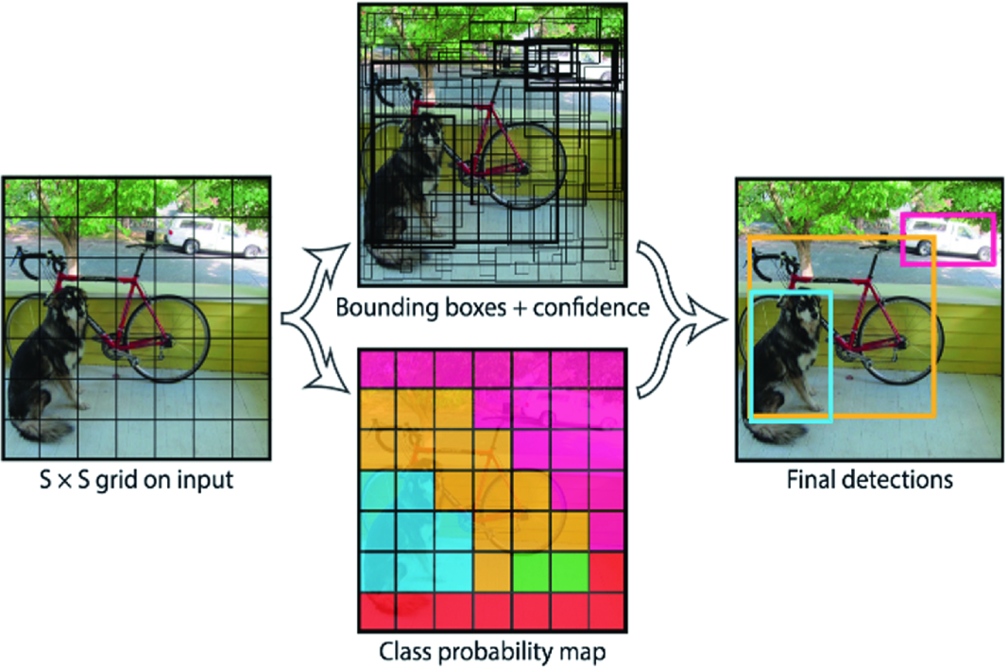
YOLO Working Principle
The entire image can be spited into the grid in SxS dimensions.
Each cell will predict confidence value for each bounding box.
Responsible for predicting class probabilities.
Anchor boxes are used to predict bounding boxes.
To predefine two different shapes.
Calculate on the Common Objects in Content (COCO) dataset.
Figure (6). YOLO working principle
13

Slide 14
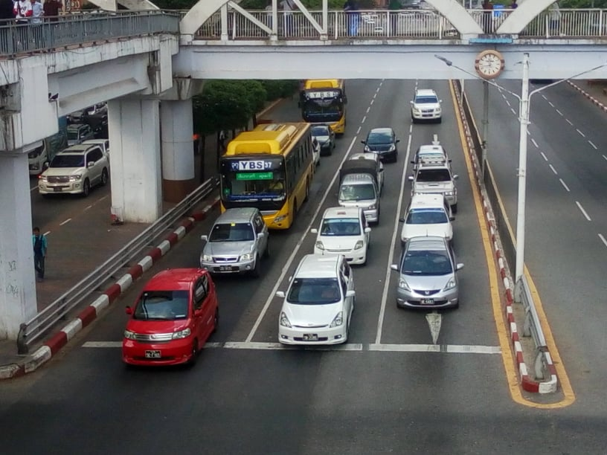
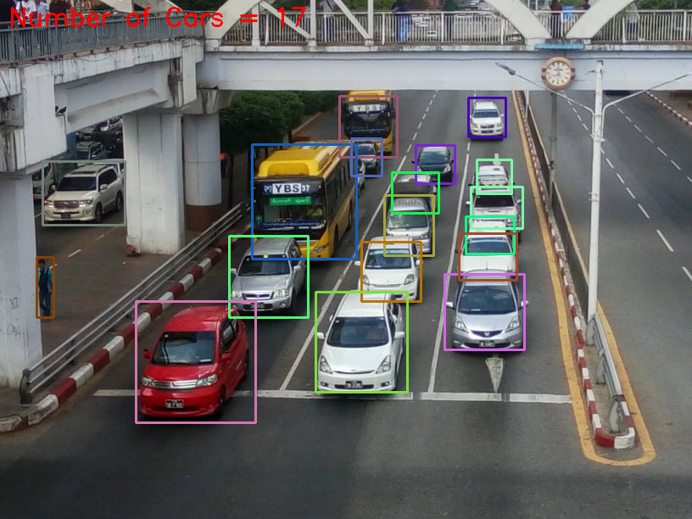
Continued;
Car Detection Input Image
Car Detection Result
14

Slide 15
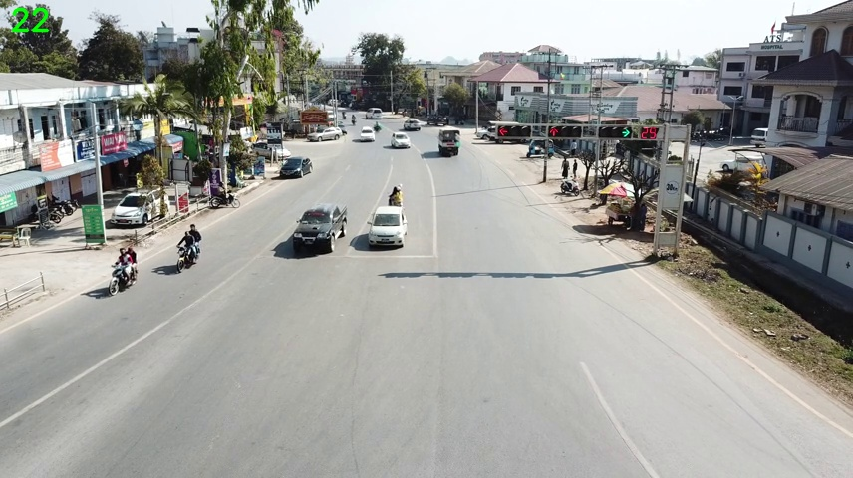
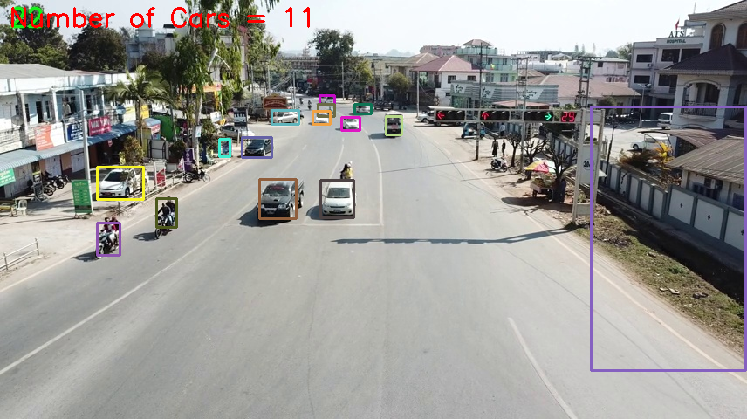
Continued;
Car Detection Image at Zay Lay Junction
Car Detection Result Image at Zay Lay Junction
Number of Cars = 11
15

Slide 16


Webster’s Method
Webster method is a rational approach for signal design.
The optimum signal cycle corresponding to the minimum total delay of the traffic at the signalized intersection can be obtained.
The cycle length is given by;
$$C=\frac{1.5 L+5}{1− \sum_{i}{Y_{i}}}$$
Where;
C = cycle length
L = Loss time ( Number of phase x t , t = 3 )
$Y_{i}$ = critical volume / saturation flow
16

Slide 17
Continued;
Passenger Car Units (PCU)
The saturation flow of a signal approach is expressed in passenger car units per hour (pcu/h).
Table 1. Value of Passenger Car Unit
Sr No. | PCU Values of Vehicles Class
 | Vehicle Class | Urban Roads Mid-block Section | Signalized Intersection | Curb Parking (Parallel and Angle)
1 | Car | 1.0 | 1.0 | 1.0
2 | Bus and truck | 2.2 | 2.8 | 3.4
3 | Auto risk shaw | 0.5 | 0.4 | 0.4
4 | Two wheeler automobiles | 0.4 | 0.3 | 0.2
5 | Pedal cycles | 0.7 | 0.4 | 0.1
6 | Bullock cart | 4.6 | 3.2 | 1.2
7 | Hand cart | 4.6 | 3.2 | 0.3
17

Slide 18












Continued;
Critical Flow Ration,
= $\frac{Traffic Flow(PCU)}{Saturated Volume(PCU)}$
$Y_{1}$,
$$Y_{2}$$
Y = $Y_{1} + Y_{2}$
$$\frac{Y_{1}}{Y}$$
Green Time 1 , = (C – L)
$$G_{1}$$
$$G_{2}$$
$$\frac{Y_{2}}{Y}$$
Green Time 2 , = (C – L)
Amber = 3s
$$G_{1}$$
Red Time 1 , = (C – ( + Amber ))
$$R_{1}$$
$$G_{2}$$
Red Time 2 , = (C – ( + Amber ))
$$R_{2}$$
Phase 1
G1
Y1
All Red
R1
Phase 2
R2
All Red
G2
Y2
Figure (7). Signal Timing of Phase-Plan
18

Slide 19
Continued;
ON
Green Time(Lane1)
OFF ON
Amber Time(Lane1)
OFF ON
Read Time (Lane1)
OFF ON
Red Time(Lane2)
OFF ON
Green Time (Lane2)
OFF ON
Amber Time (Lane2)
OFF | Delay (seconds)
Figure (8). Timing Diagram of Phase-Plan
19

Slide 20
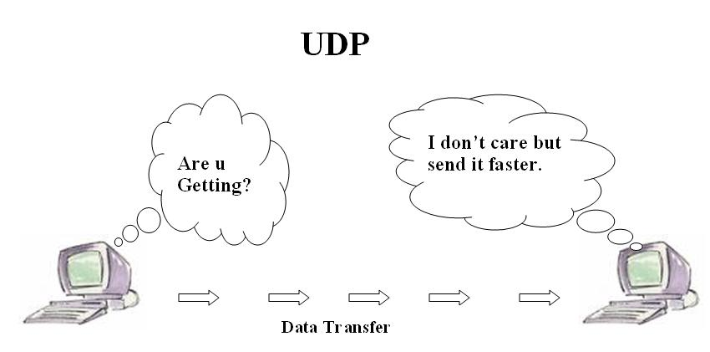
User Datagram Protocol
One of the core members of the Internet protocol suite.
Facilitates the exchange of messages between computing devices in a network.
Include port numbers in the datagram header.
Doesn’t have the error checking.
Commonly used in time-sensitive communications.
Figure(9). User Datagram Communication
20

Slide 21
Main Control Unit Flow Chat
Start
Initialization
Server Start
Send to client by UDP
Car Counting with YOLOv3
Object Detections
Receive
data
Yes
Ready
No
Traffic Data insert into Database
MySQL Database
Select data from database
Calculate
Cycle time
Send data to Arduino by UDP
Figure(10). Flow chat for Main Control Unit
21

Slide 22
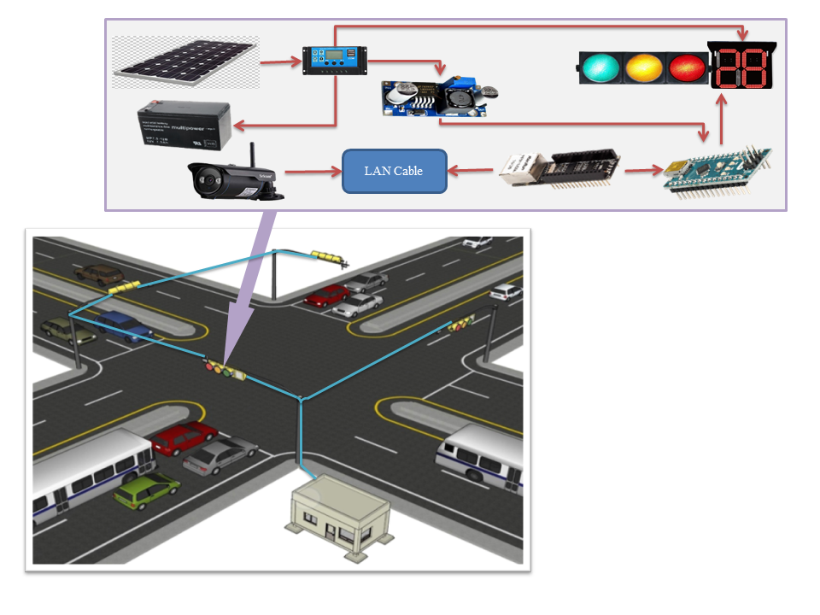
Traffic Control Unit
Solar panel
Battery
Solar Charge Controller
Controller
ENC28J60 Ethernet Module
Seven Segment Display
CCTV IP Camera
Buck Converter
Figure(11). Traffic Control Unit
22

Slide 23
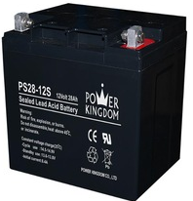


Battery
Required Power for controller = 3.15 W
Required power for LEDs = 3.75 W
Total Watts, P = 3.15 + 3.75 = 7 W
For 1 days, E = 7W x 24hr = 168 Wh
Ampere hour per day, Ah = 168Wh / 12V = 14Ah
Battery Capacity =
= = 35 Ah
Required Battery = 12V 35Ah
$$\frac{A x Stand by day}{Max DOD x Derate Factor}$$
Figure(11). 12V 35Ah Battery
$$\frac{14 x 2}{0.8 x 1}$$
23

Slide 24
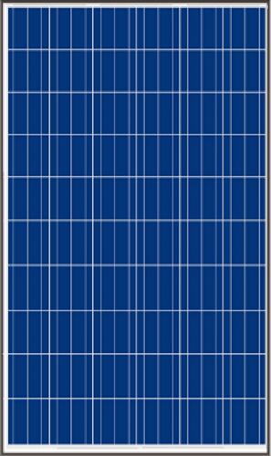

Solar Panel
Voltage at maximum power (Vmp) : 18V
Current at maximum power (Imp) : 2.22A
Open circuit voltage (Voc) : 21.24V
Short circuit current (Isc) : 2.5A
Panel Efficiency : 12.84 %
Panel Area : 0.276 $m^{2}$
Figure(11). Solar Panel
24

Slide 25
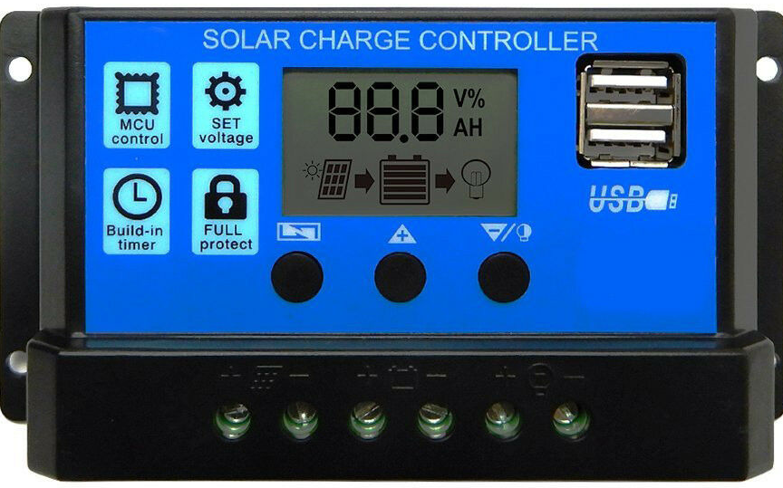
Solar Charge Controller
Used to charge a battery.
Operational amplifiers are used to monitor panel voltage and load current continuously.
The solar energy is bypassed using a transistor to a dummy load when the battery gets full charging.
protect the battery from over charging.
Figure (17). Solar Charge Controller
25

Slide 26
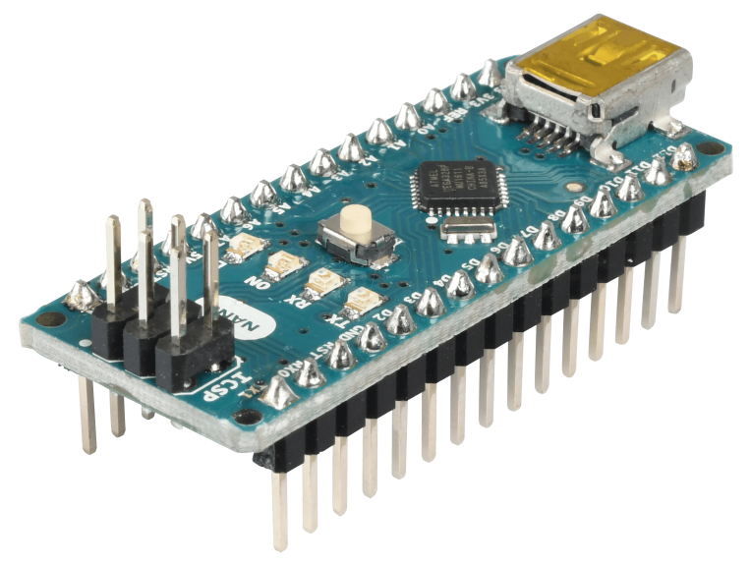
Controller
Arduino Nano is used to control signal and timing.
Arduino Nano is a small, compactable, flexible and breadboard friendly Microcontroller board.
Numbers of Input / Output Pins are compatible.
Operating voltage is 5V, can vary from 7 to 12V.
Figure(12). Arduino Nano
26

Slide 27
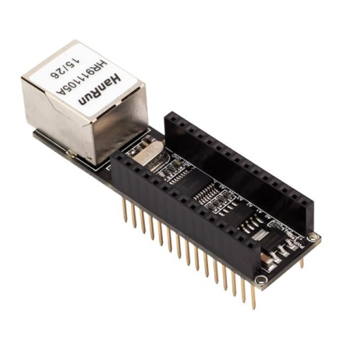
ENC28J60 Ethernet Module
Standalone Ethernet unit with on board MAC and PHY, 8 Kbytes of Buffer RAM and an SPI serial interface.
Provide a network (IP) stack capable of both TCP and UDP.
Data-rate is limited to 10 Mbps.
Connect it to network with an RJ45 cable.
Supply voltage is 3.3V or 5V.
Figure(13). ENC28J60 Ethernet Module
27

Slide 28
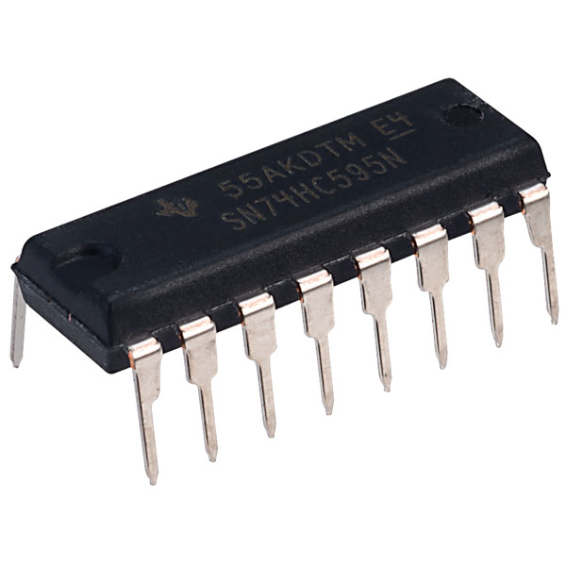
74HC595 Serial to Parallel Shift Register
8-bit serial-in / serial or parallel-out shift register with a storage register and 3-state outputs.
Takes 8 bits from the serial input and outputs 8 pins.
Shift register and latch have independent clock inputs.
Connect more than 1 shift register in parallel.
Operating Voltage is 2V to 6V.
Figure (14). 74HC595 shift register
28

Slide 29
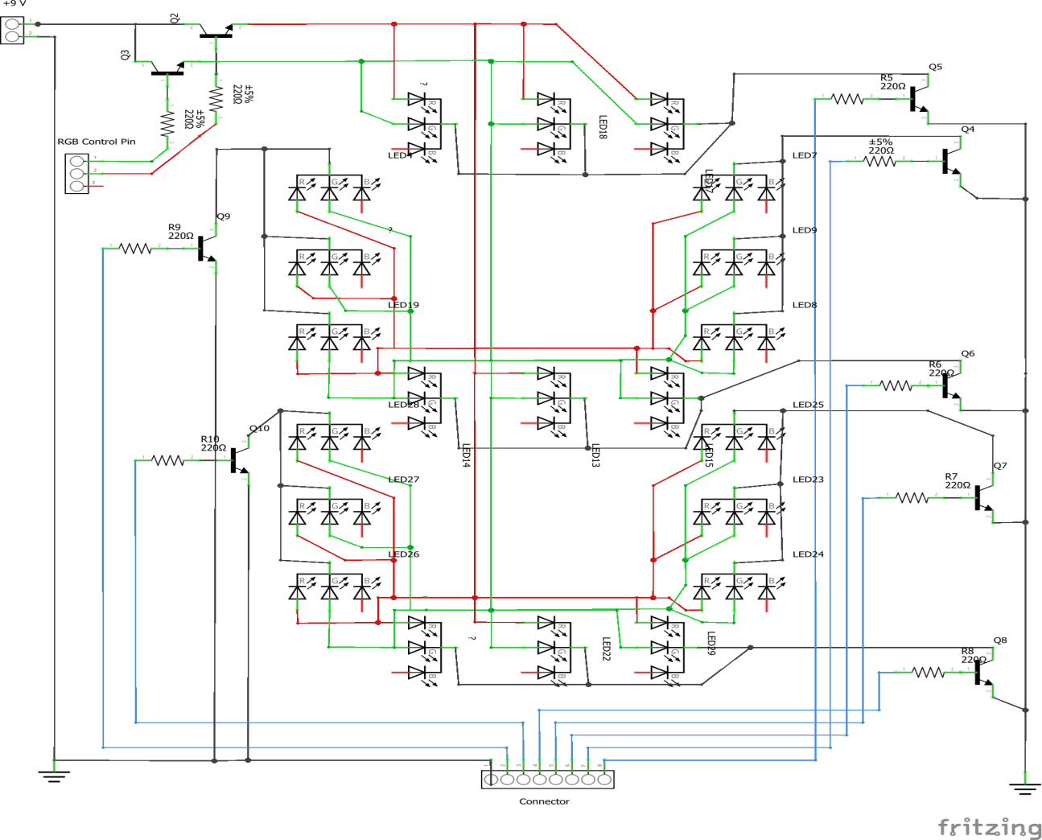
Seven segments Display Construction
Construct with RGB leds and transistors.
Can display number with traffic signal color.
Figure(15). Circuit Diagram of RGB Seven Segments Display
29

Slide 30
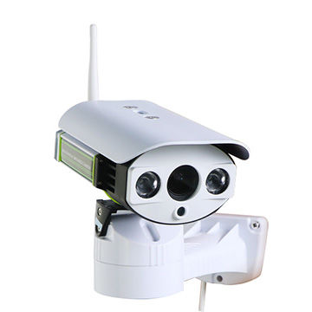
CCTV IP Camera
Use of video cameras to transmit a signal to a specific place, on a limited set of monitors.
Employ point-to-point (P2P), point-to-multipoint (P2MP) by using wired or wireless links such as IP address.
Used to monitor traffic conditions.
Send data to main control unit.
Figure(16). CCTV IP Camera
30

Slide 31
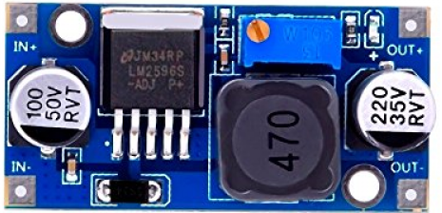
Buck Converter
Used to step down the input dc voltage.
Consists of an inductor, diode, capacitor, switch and error amplifier with switch control circuitry.
Vary output voltage is adjusted by precision potentiometer.
Figure(18). Buck Converter
31

Slide 32
Traffic Control Unit Flow Chat
Start
Initialization
Connect server
Yes
Receive data ?
Send ‘ready’ to server
Split timer count
No
Count --
Yes
Count > 0
No
Send data to 74HC595
Display
7 Segments
LED ON
32
Figure(19). Flow chat for Traffic Control Unit

Slide 33
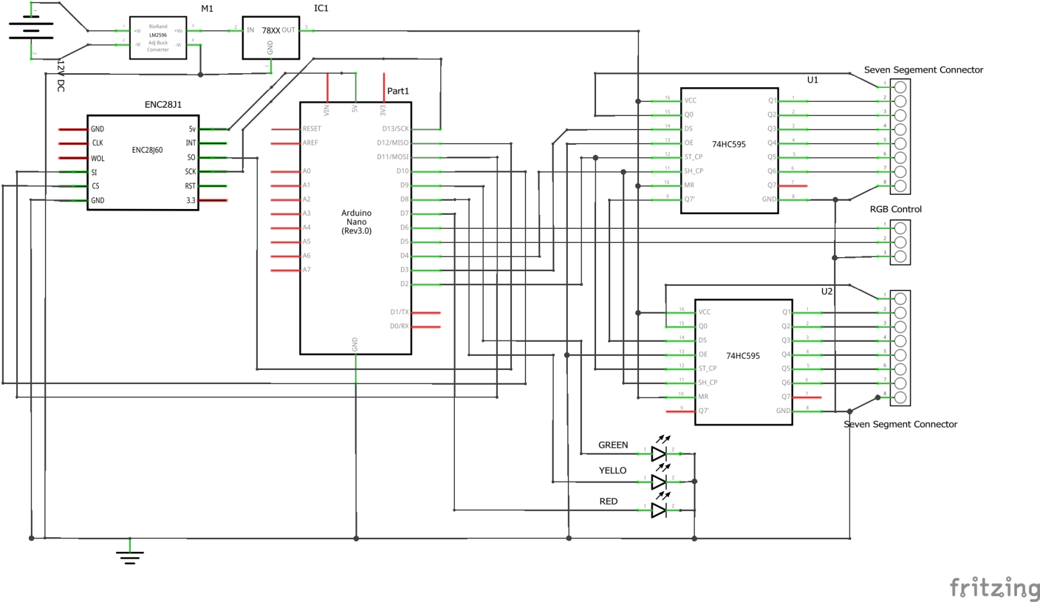
Circuit Diagram for Traffic Control Unit
Figure(20). Circuit Diagram of Traffic Control Unit
33

Slide 34
34

Slide 35
Conclusion
Traffic status collects camera.
Cars counting with YOLOv3 and Python.
Calculate timing cycle, green split time and red time with Webster’s Methods.
Send update cycle time to traffic control unit by UDP protocol.
Traffic timing cycle time can be change according to traffic condition.
35

Slide 36
Future Work
To implement traffic control unit.
Connect with main control unit and CCTV IP Camera.
Calculate Camera positon and angle for each phase.
System implementation and testing with signalize traffic junction.
36

Slide 37
Any Comments And Suggestions?
37

Slide 38
Thank For Your Attention
36

